Slide 1
Emotion/Sentiment Analysis of Tweets
Anantharaman Janakiraman (aj4@Illinois.edu) - Project Coordinator
Hsien-Cheng Allen Pu (hapu2@Illinois.edu) - team member
Margaret Weglarz (weglarz3@Illinois.edu) - team member
Zhan Simeonov (zsimeo2@Illinois.edu) - team member

Slide 2
Project Inspiration
The idea transpired after the divisive US Presidential debate aired on NBC
Hurtful, divisive, and vitriol languages permeated on various social media platforms
We want to use what we learned in class (topic/sentiment mining) to analyze how the millennials feel about the current election cycle
We want to mine people’s opinion across social media platforms to gauge sentiment and ultimately, if time permits, break down social media users by racial/ethnical background, social-economic status, education, age-group, and etc. to judge how each subgroup feels about the current election

Slide 3
Why topic/Sentiment Mining?
We can mine a variety of useful inferences from user interactions
Topics currently trending
Provide real-time data to perhaps feed into high-frequency trading algorithms
Current issues
Provide media companies with potential stories to write that people are passionate about
Product reviews
Provide insights to companies of how consumers feel about their product offering
Furthermore, we can use this information as baseline to predict the outcome of next presidential election in 2020

Slide 4
Approach
We chose twitter as the social media platform of choice
It provides real-time assessment of people’s sentiment, jubilation, and uncertainty
Most twitter users are of the target audience – the millennials
The objective is to label the “emotions” of the tweets in two categories of sentiment gradient using the trained classifiers
‘4’ – Positive, happy, jovial, and etc.
‘2’ – Neutral, okay, don’t care, “meh,” and etc.
‘0’ – Negative, anger, fear, hate, and etc.
We decide to use MeTA to accomplish this task due to general familiarity

Slide 5
Approach (con’t)
We manually assign sentiment label on a dataset consists of 4550 tweets – ‘4’ being generally positive, ‘0’ being generally negative, ‘2’ being generally neutral
We use the dataset to train both generative and discriminative classifiers
Naïve-Bayes
Logistic Regression
Winnow
One-vs-All
One-vs-One
Dual-Preceptron

Slide 6
Approach (Con’t)
We remove stop words, perform stemming and additional data cleaning/filtering, prior to training the classifiers
We fine-tune the classifiers to achieve best precision, recall, and F1 scores
We use the trained classifier to analyze tweets in real-time
Since the election is over, we would use the saved tweets to compare and contrast between different classifiers

Slide 7
Code Implementation – Training THE Classifier
We created a ‘sentiment.cpp’ file within MeTA to:
Treated each tweet as a document – with sentence boundary denoted by ‘%’
Each tweet was tokenized using ‘whitespace_tokenizer’
Used default MeTA ‘list_filter’ to remove stopwords
Used ‘english_normalizer’ to clean and normalize english words
Used ‘porter2_filter’ for stemming
Used other techniques to clean data like for example removing leading punctuations that were causing sentence boundary issues, converting non-alpha in a document to UTF, updated % to word “percent” because % was being for identifying sentence boundary etc.
We created a ‘config1.toml’ file to specify each unique classifier and tried different config parameters and methods for feature selection, analyzers/filters (ngrams, filter chains etc) and smoothing.
We identified problem in MeTA that caused incorrect labels to be produced on the test data and modified the classifier algorithm (Naïve Bayes particularly) to output the predicted label to a file directly from the algorithm

Slide 8
Code Implementation – Training THE Classifier (con’t)
We ensured that the code can handle multiple sentiment labels.
We ensured the index is removed from the system after the classifier completes execution to recover storage space.
We compiled the code after making appropriate changes to CMakeList.txt and ran the code. The code handles multiple polarities too.

Slide 9
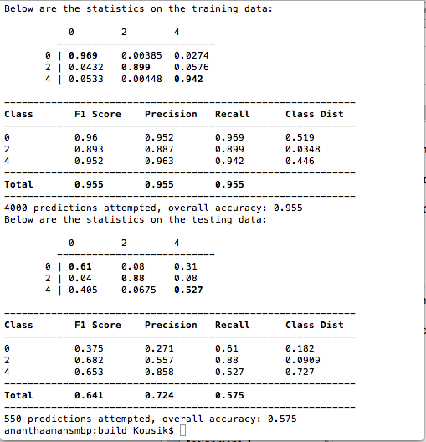
Trained Classifier Result – Naïve-Bayes
Update

Slide 10
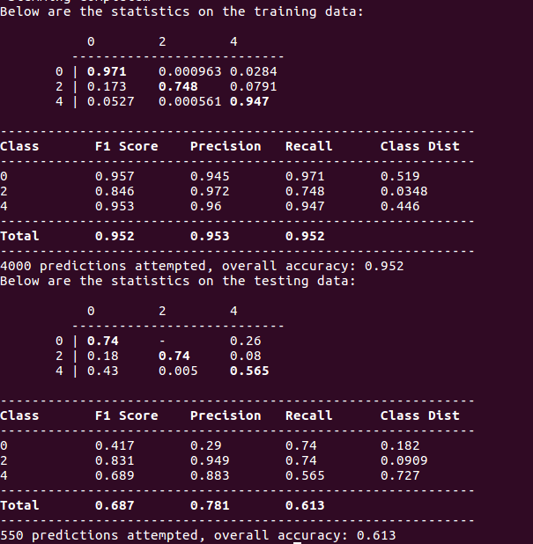
Trained Classifier Result – Logistic Regression

Slide 11
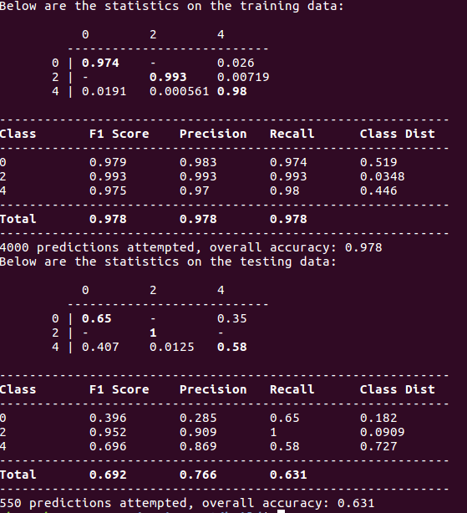
Trained Classifier Result – Winnow

Slide 12
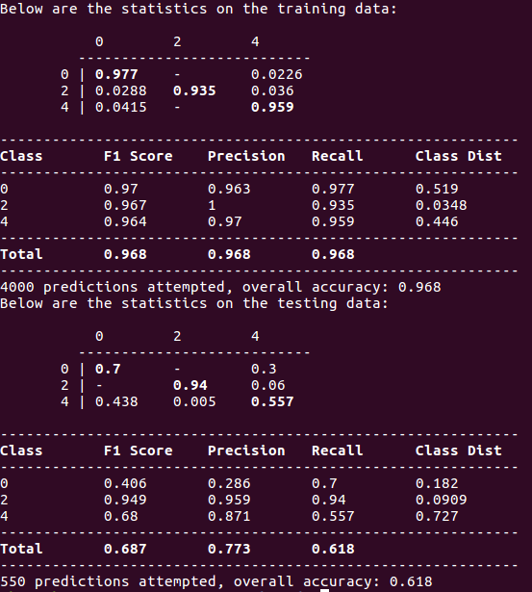
Trained Classifier Result – One-vs-all

Slide 13
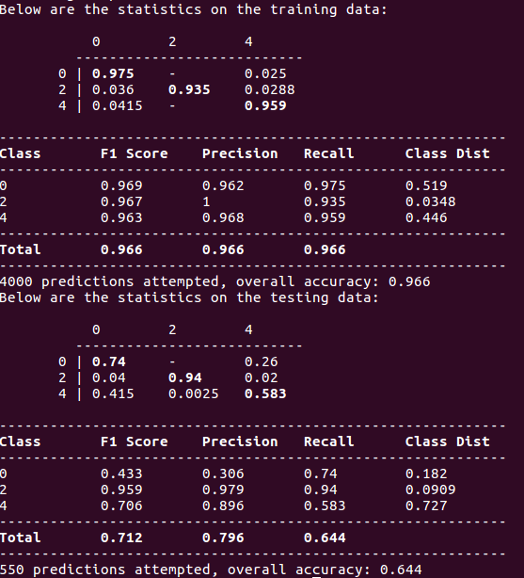
Trained Classifier Result – One-vs-ONE

Slide 14
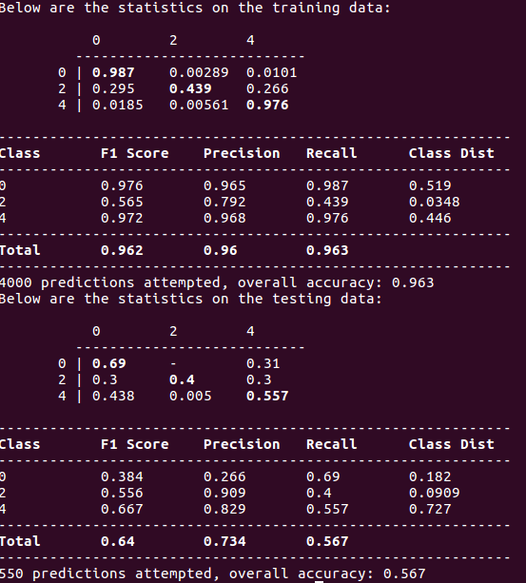
Trained Classifier Result – Dual-Perceptron

Slide 15
Trained Classifier Result - Summary
Classifier | F1 | Precision | Recall | Overall
Naïve-Bayes | 0.955 | 0.955 | 0.955 | 0.955
Logistic Regression | 0.952 | 0.953 | 0.952 | 0.952
Winnow | 0.978 | 0.978 | 0.978 | 0.978
One-vs-All | 0.968 | 0.968 | 0.968 | 0.968
One-vs-One | 0.966 | 0.966 | 0.966 | 0.966
Dual-Perceptron | 0.962 | 0.960 | 0.963 | 0.963

Slide 16
Test Classifier Result - Summary
Classifier | F1 | Precision | Recall | Overall
Naïve-Bayes | 0.641 | 0.724 | 0.575 | 0.575
Logistic Regression | 0.687 | 0.781 | 0.613 | 0.613
Winnow | 0.692 | 0.766 | 0.631 | 0.631
One-vs-All | 0.687 | 0.773 | 0.618 | 0.618
One-vs-One | 0.712 | 0.796 | 0.644 | 0.644
Dual-Perceptron | 0.640 | 0.734 | 0.567 | 0.567

Slide 17
Code Implementation – Testing THE Classifier
We used Naïve-Bayes classifier as baseline to measure performance against other classifiers
We used a dataset of 4550 tweets to accomplish this task:
A training dataset consisting of 4000 tweets with three human assigned sentiment labels (positive, neutral, and negative) to train classifiers.
A test dataset consisting of 550 tweets to feed it through the trained classifiers.
We modified the “sentiment.cpp” file to incorporate both elements of training and testing as suggested in the MeTA classification tutorial

Slide 18


Code Implementation – Testing THE Classifier (con’t)
Training a classifier (sample code):
Testing a trained classifier (sample code):
For a fuller discussion, see https://meta-toolkit.org/classify-tutorial.html for details

Slide 19
Some Observations
Based on the sample of 550 test tweets the best accuracy was 0.644 on One-vs-One classifier with 4000 trained tweets - not good enough!
To improve accuracy, we need to substantially increase the size of the size of dataset to train the classifiers.
We plan to increase the training set from 4000 currently to around 100K tweets

Slide 20
Real-world Application
It is our intention to create a web GUI with MeTA as the sentiment engine to classify tweets, documents, or any other text-data application real-time – “Online Classifier”.
Tweets, documents, or any text-data can be processed in batches or one-at-a-time
Implemented with one-vs-all or one-vs-one respectively
It is an easy-to-use interface for people to:
Quickly upload topic/sentiment training data with unique labels and get real-time results
Tending topics (to discover new exciting topic), product reviews (to discover features customers like or dislike), service reviews (to discover what the customers are saying), and etc.
Perform twitter sentiment analysis using the classifiers we built in this project!

Slide 21
Conclusion
Based on results of test classification, we concluded that the One-vs-One classifier returned the best results
We will continue to train and improve the accuracy of top-3 classifiers
We will continue to develop an online classifier with a web interface using Scikitlearn NLTK/MeTA
Stay tuned

Slide 22
Possible Future Improvements
We would like to do emotion analysis of tweets classified into Anger, Fear, Surprise etc.
We would like to explore twitter API to extract user data to analyze sentiment among the subgroups
We would like to explore other concepts learned in class to make text-based predictions
Perhaps explore sentiment between the subgroups using NetPLSA or Contextual PLSA
Sometime in the distant future, we would like to implement concepts in statistical machine learning and leverage “big data” to predict the next presidential outcome

